Slide 1
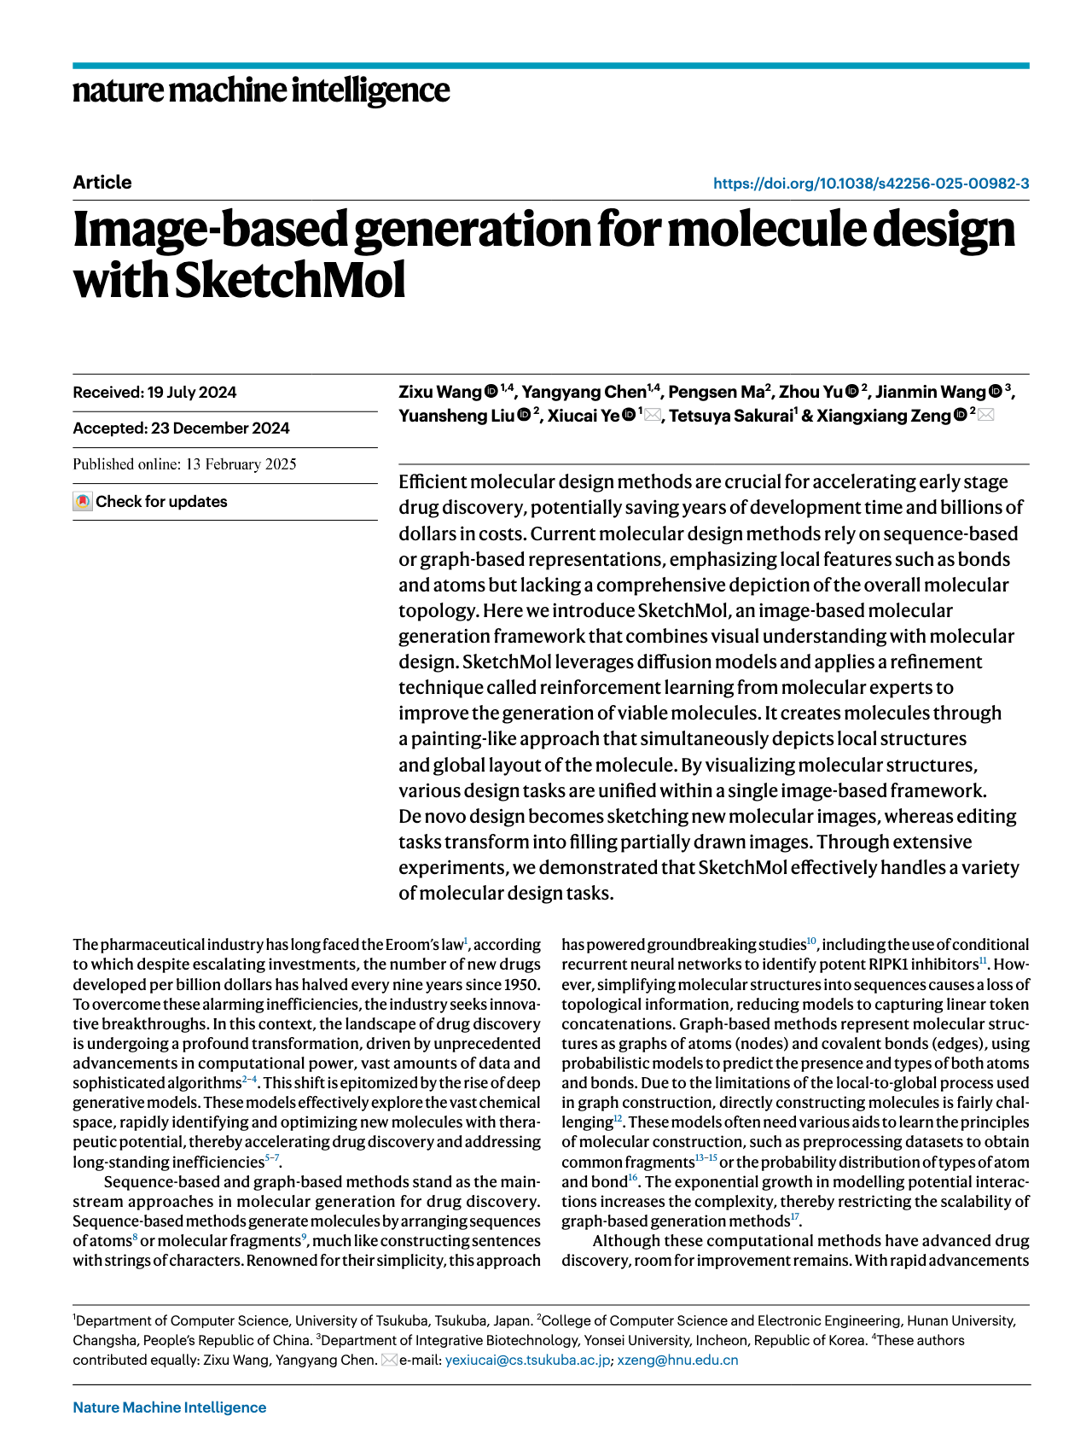
SketchMol at a Glance
Existing Representations
Research Background
Eroom's law
We need better efficiency in molecule design
Sequence: SMILES Graph structure
Both have limitations
Roadmap
• Drug discovery faces persistent efficiency challenges, motivating better generative design methods
• SketchMol represents molecules as images rather than only sequences or graphs
• The framework unifies de novo design and molecular editing through a visual generation workflow
• Research focus: conceptual understanding, methodology, and evidence from the paper

Slide 2
Why Move Beyond Sequences and Graphs?
Representation Shift
Molecular generation needs a representation that captures both chemically meaningful local structure and the overall organization of the molecule.
A compact comparison of the main molecular
representation choices.
• Representation | What it captures well | Main limitation
• Sequence | Simple serialization and easy use with language-style models | Can obscure global topology and long-range structural relationships
• Graph | Explicit atom-bond connectivity and chemical structure | Construction, manipulation, and scaling can be difficult for generation pipelines
• Image | Local visual detail and whole-structure layout in one space | Requires learning a valid visual-to-chemical correspondence
What the generation task really demands
• Molecular design is not only about correct atoms and bonds
• It also requires a coherent global arrangement so the whole structure makes sense as one object.
Why image-based modeling is plausible
Image generation models are designed to capture fine local patterns while maintaining global spatial consistency.
That makes them a natural candidate for molecule generation when we want to model detailed substructures and overall molecular organization together.

Slide 3
The Core Idea: Molecules as Visual Objects
The paper’s key shift is to treat a molecule not only as a symbolic string or graph, but as a visual object that can be created and edited directly in image space. In one view, a molecular image can expose atom types, bond patterns, and overall spatial arrangement, making the design process easier to align with human intuition.
Old interface: Symbolic encoding is powerful, but it separates representation from how people naturally sketch and revise structures.；New interface: An image becomes a single workspace for generation, modification, and inspection.
See the whole molecule at once
A molecular image can display atom identities, bond connections, and global shape in one integrated view instead of splitting these cues across separate symbolic forms.
Generate de novo by drawing
Creating a new molecule becomes analogous to drawing on a blank canvas: the model generates a complete structure directly in visual form.

Slide 4
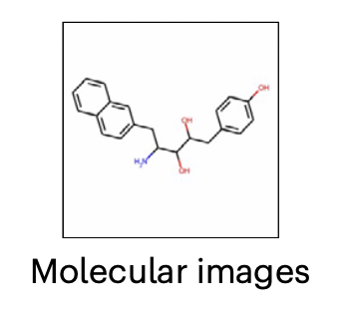
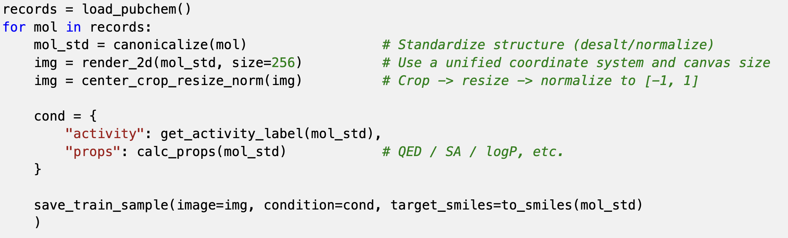
SketchMol Architecture Overview (Training Stage)
Data Preparation • Obtain molecular structures from molecular datasets (such as PubChem);
• Render into normalized 2D molecular images;
• Perform necessary preprocessing (cropping, scaling, normalization, etc.);
• Prepare labels for conditional generation (such as activity, property ranges, or target constraints).

Slide 5
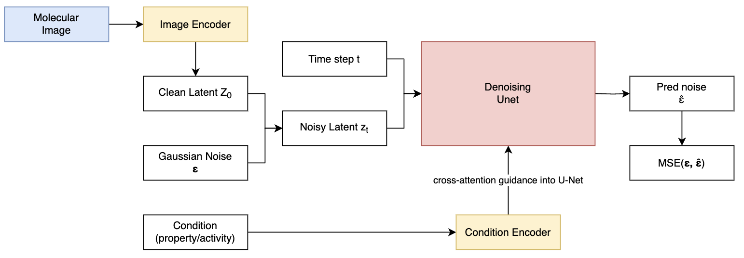
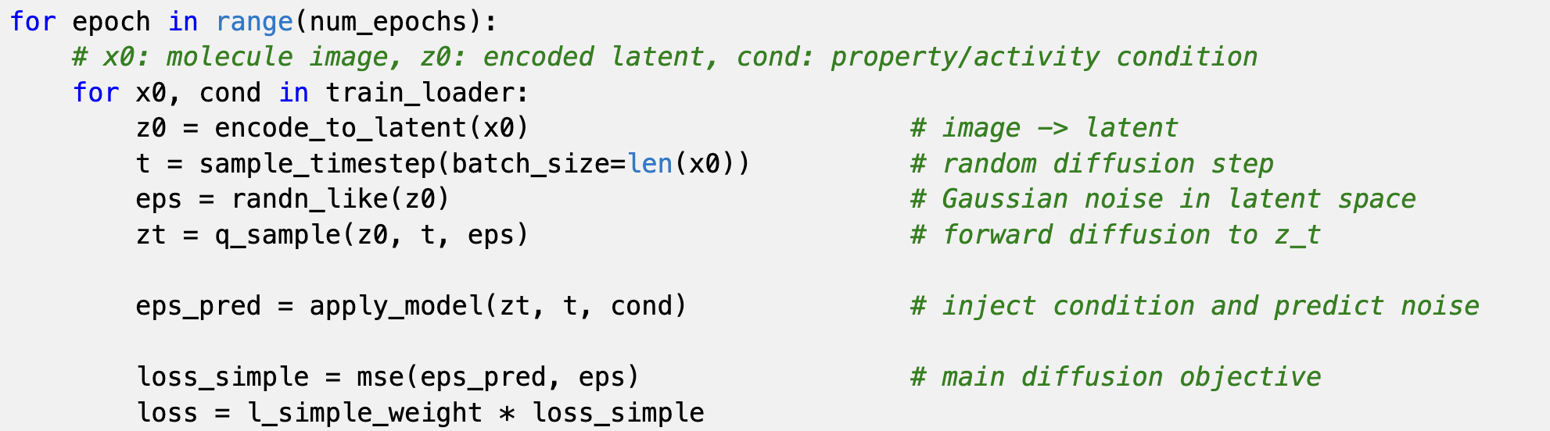
Training Stage
The main task is to "predict the added noise," and once learned, it can perform reverse denoising during sampling;

Slide 6
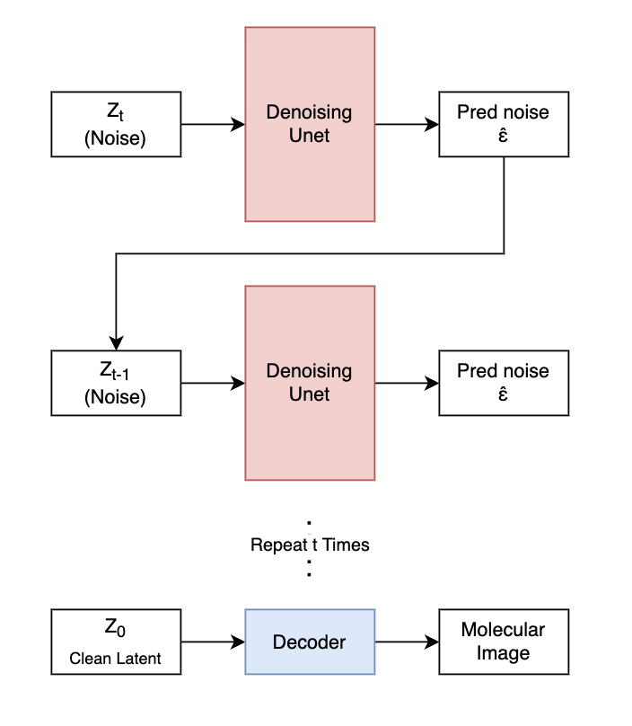
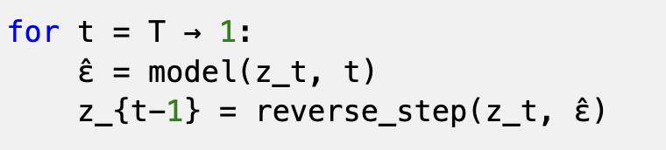
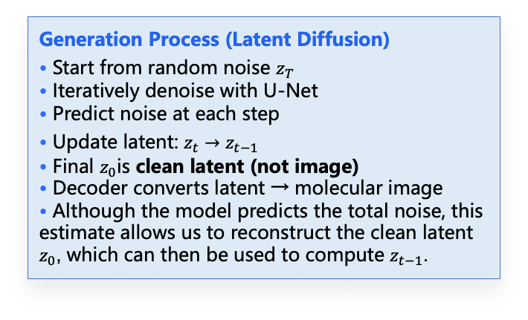
SketchMol Architecture Overview (Generation)
Generation Process (Latent Diffusion)
• Start from random noise $z_{T}$
• Iteratively denoise with U-Net
• Predict noise at each step
• Update latent: $z_{t}→z_{t−1}$
• Final $z_{0}$is clean latent (not image)
• Decoder converts latent → molecular image
• Although the model predicts the total noise, this estimate allows us to reconstruct the clean latent $z_{0}$, which can then be used to compute $z_{t−1}$.
Next Slide: How to Control the generation

Slide 7
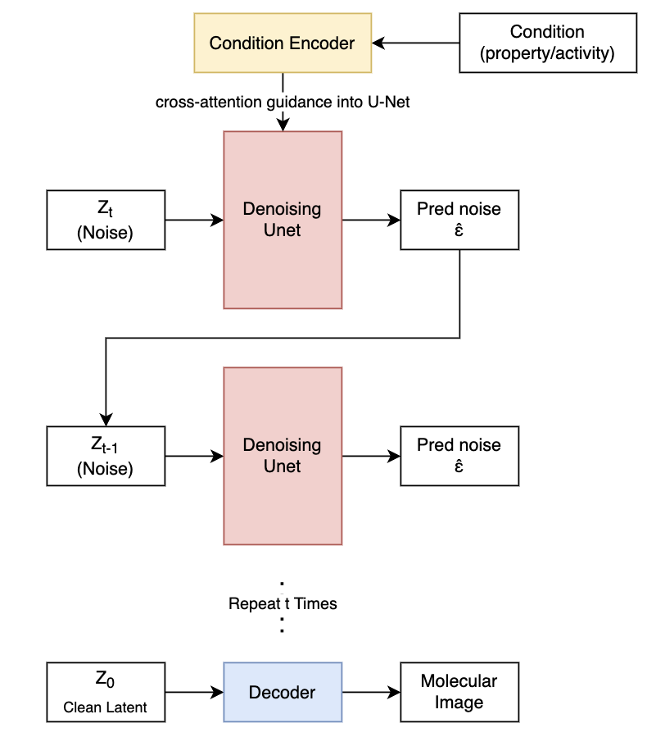
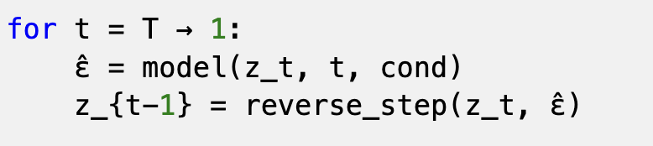
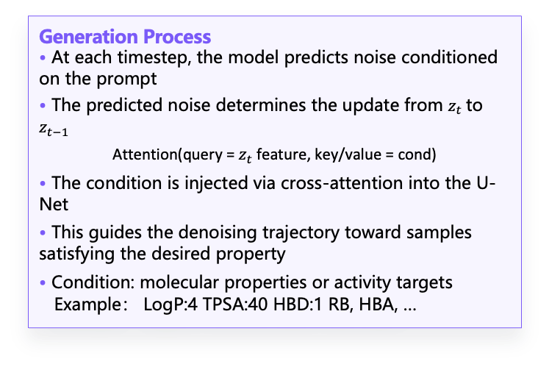
Conditional Sampling via Guided Denoising
Generation Process
• At each timestep, the model predicts noise conditioned on the prompt
• The predicted noise determines the update from $z_{t}$to $z_{t−1}$
Attention(query = $z_{t}$feature, key/value = cond)
• The condition is injected via cross-attention into the U-Net
• This guides the denoising trajectory toward samples satisfying the desired property
• Condition: molecular properties or activity targets Example： LogP:4 TPSA:40 HBD:1 RB, HBA, …
Next Slide: Editing

Slide 8
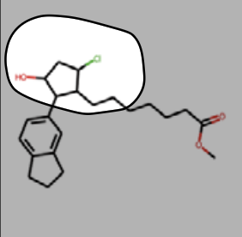
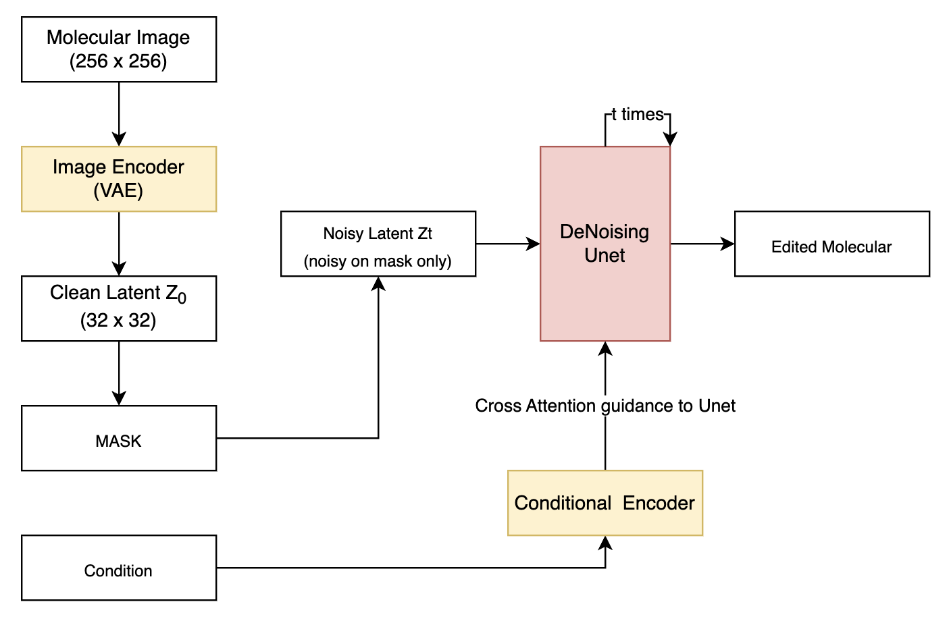
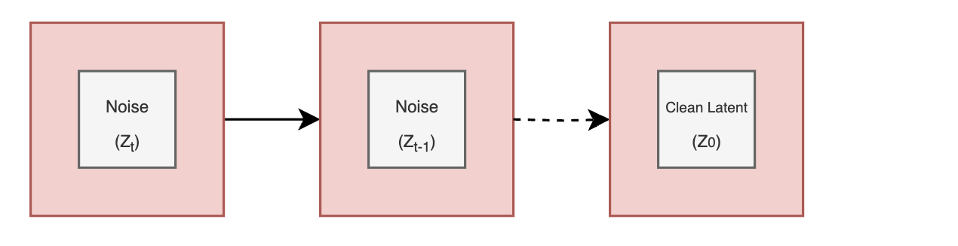
Inpainting for Local Molecule Editing
Molecule Editing Process • A mask specifies the region to be modified • Noise is applied to the masked region while preserving the rest • At each step, the model predicts noise conditioned on the target property • The unmasked region is reset to the original latent to preserve structure • The masked region is gradually generated via diffusion • Enables local editing while maintaining global consistency

Slide 9
RLME(Reinforcement Learning from Molecular Expert)
Core Motivation
In molecular image generation, realism is not enough. A generated image must also preserve chemically meaningful structure, such as readable atoms, valid connectivity, and plausible bonding patterns. This makes molecular generation a stricter problem than ordinary natural-image synthesis
Failure Modes of Naive Generation
• Diffusion models may produce images that look plausible at a glance but do not correspond to valid molecular structures.
• Because molecular images are sparse and highly structured, small visual errors can destroy chemical meaning.
• Typical problems include blurry or low-quality depictions, unreadable atom or bond layouts, and irrational bonding patterns.
• A visually smooth sample can still fail downstream molecular interpretation or expert validation.

Slide 10
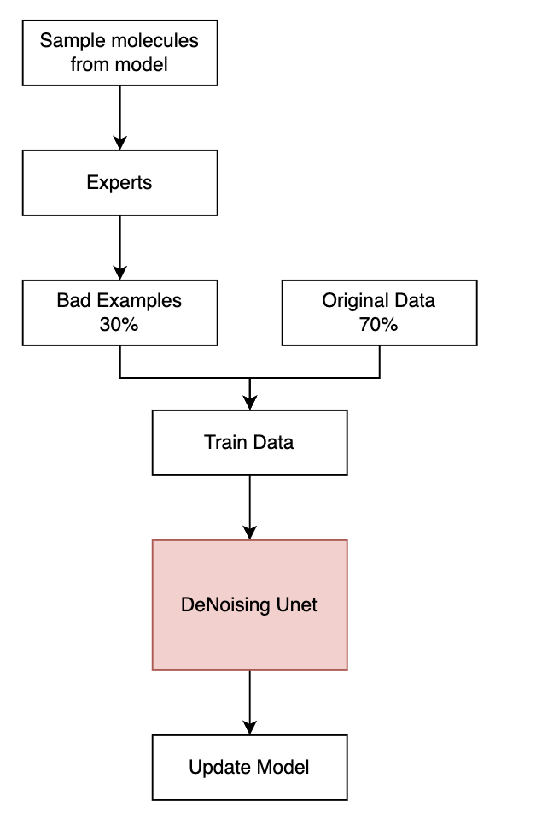
RLME (Fine Turn after Training Stage)
Core Idea • Generated molecules are evaluated by expert models (oracles) • Experts assign rewards based on desired properties • The model is optimized to generate higher-reward molecules
What is an Expert?
• External evaluation function (not part of the model) • Examples: – Property predictors (QED, LogP, etc.) – Chemical validity checks (RDKit)
Model Update
• Step 1: sample molecular images from current model
• Step 2: evaluate generated images with molecular experts • Step 3: build augmented feedback dataset (paper says problematic images are about 5% of training set size)
• Step 4: fine-tune the model using mixed training data (original data + expert-identified bad cases, e.g., 70% / 30%)

Slide 11
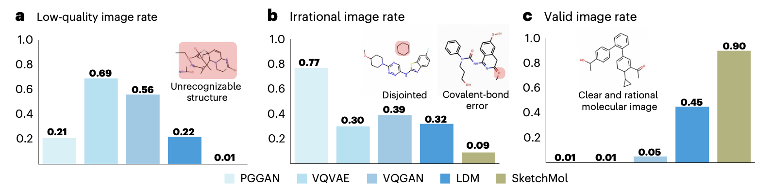
Quantitative Evaluation of Generated Molecules
• SketchMol significantly reduces low-quality generations • Dramatically lowers irrational molecular structures • Achieves the highest valid image rate (0.90)
• Prior methods often generate unrecognizable or chemically invalid structures • SketchMol produces clear, chemically consistent molecules

Slide 12
Conclusion & Future Directions
Main Contribution
Key Strength
• Proposes a unified visual-based molecular generation framework • Reformulates molecule design as image generation and editing • Integrates conditional control for property and activity guidance • Improves generation quality in both validity and interpretability
• Unified design for generation, editing, and inpainting • Intuitive image-based interface for molecule manipulation • Strong improvement in structural validity and chemical consistency • Flexible conditioning for multi-objective control
Limitations
• Limited expressiveness of 2D representations, lacking 3D geometry and stereochemistry • Reliance on OCR-based back-translation (e.g., MolScribe), introducing additional errors • Performance degrades for high molecular weight or complex structures

